Slide 1
Ensuring our school is fire ready

Slide 2
What is the Government doing?
Fire Danger Ratings – to help you understand forecast fire danger to make timely decisions.
Community Information Guides for high risk communities https://www.cfa.vic.gov.au/plan-prepare/community-information-guides
Information regarding preparing for fires https://emergency.vic.gov.au/prepare/#fire/preparing-for-fires .
Access to information about emergencies and incidents near you (VicEmergency app, VicEmergency website)
Neighbourhood Safer Places (Bushfire Place of Last Resort) –these are locations that may provide some protection from direct flame and heat from a fire, but they do not guarantee safety – your nearest NSP can be found here http://www.saferplaces.cfa.vic.gov.au/cfa/search/default.htm
Fire Ready Kit – available for all Victorians on the CFA website to help you understand your bushfire risk, prepare your property and develop a Bushfire Survival Plan.

Slide 3
What is our school doing?
This year we have:
Updated our emergency management plan, in consultation with local emergency services and Council
Reviewed how we communicate with parents
Reprioritised vegetation management works
Cleared gutters and grounds and other priority works.
We are discussing the importance of being bushfire ready with your children (supported by specifically-developed curriculum).

Slide 4
Planned closure of schools and early childhood services
Schools and children’s services including outside-school-hours-care services listed on the Bushfire At Risk Register (BARR) will be closed on days when the Fire Danger Rating is determined by the Emergency Management Commissioner as being Code Red.
All bus routes co-ordinated by schools on the BARR will also be cancelled.

Slide 5
How will parents be advised of a planned closure?
Where possible, the forecasting of a Code Red day will provide up to 4 days notice of a planned closure (including warnings about cancelling, changing, rescheduling or recalling off-site activities, such as camps and excursions), as well as information about cancellations of school bus routes.
You will be advised by email or letter sent home from school – you can also check for updates at http://www.education.vic.gov.au/about/programs/health/pages/closures.aspx
You should expect that, in some instances, fewer than 4 days notice may be given.
The final decision to close will be confirmed no later than 1.00 pm the day before the potential closure by the Emergency Management Commissioner.
Once the decision to close is made, this will not change – regardless of changes in weather forecast – this will help limit confusion and provide time for you to make alternative care arrangements for your children.

Slide 6
Closure – other than planned
While every effort is made to anticipate fire threats, our school may be threatened by an unpredicted outbreak of a fire or a known fire may unexpectedly change its course.
When this occurs, our Emergency Management Plan will ensure that we respond to the threat in a planned, timely and appropriate manner.
We have developed our Emergency Management Plan in consultation with local emergency services and local government authorities.
Closure updates, including advice on re-opening is available from the Department’s website http://www.education.vic.gov.au/about/programs/health/pages/closures.aspx

Slide 7
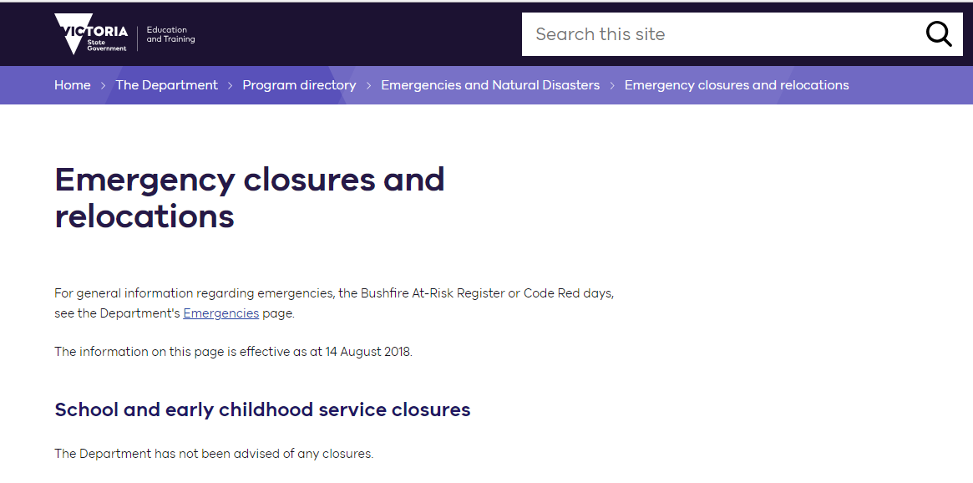
School Closure – DET website

Slide 8
What can you do?
Make sure your family’s bushfire survival plan is up-to-date, including how your child will be cared for when their school or childcare service is closed due to threat of fire. Your child should not be left unattended.
Make sure we have your current contact details, including mobile phone number.
Keep in touch with us – read newsletters, check websites, talk to your child’s teacher and other parents.
Understand our Emergency Management Plan.
Talk to your child about bushfires and your family’s bushfire survival plan.
Talk to us – your principal, teacher or school council representative, if you have any concerns.

Slide 9
Frequently asked questions and answers
Q. When the school is closed, will any staff remain on-site?
No. The safety of staff and students is our main priority and no staff will remain on-site.
What happens if the forecast improves?
The final decision to pre-emptively close a school will be made at 1.00 pm the day prior to the planned closure. Any improvements in the weather forecast after this time will not change the decision to close – this will help limit confusion and provide time for parents to make alternative care arrangements for your children.
Q. Is it likely that schools will be closed for consecutive days? If yes, how will parents be advised?
It is possible that schools will be closed for consecutive days. If this occurs, we will endeavour to contact you. However as we are on the Bushfire At-Risk Register, our school will be closed on all days determined Code Red. You should also check the Department’s website for updates – http://www.education.vic.gov.au/about/programs/health/pages/closures.aspx

Slide 10
Frequently asked questions and answers
Q. If I’m concerned about the risk of fires, can I keep my child away from school, even if the school remains open?
Yes. If your family decides to enact its bushfire survival plan, the most appropriate place for your child may be with you and your family, and not at school. You should advise your school as soon as possible of your child’s absence.
Q. On average how many days each bushfire season does the government predict that schools will need to close?
While we cannot predict the exact number of days, it should be noted that there has not been a determined Code Red day since January 2010.

Slide 11
For more information go to: http://www.education.vic.gov.au/about/programs/health/Pages/emergencies.aspx
Additional resources:
• VicEmergency app – that can be downloaded on your android and iOS mobile devices
• VicEmergency Hotline (1800 226 226)
• Website https://emergency.vic.gov.au
• Facebook (https://www.facebook.com/vicemergency)
• Twitter (https://twitter.com/vicemergency)
• ABC local radio, Sky News and other emergency broadcasters

